Slide 1
Data Scientist Essentials
Kunling Geng
Oct. 2017

Slide 2
Data Science Outlook
Demand for deep analytical talent in the United States could be 50 to 60 percent greater than its projected supply by 2018.” The result may be a shortage of “140,000 to 190,000 people with deep analytical skills.”
Data science careers are growing in virtually every sector: manufacturing, construction, transportation, warehousing, communication, science, health care, computer science, information technology, retail, sales, marketing, finance, insurance, education, government, security, law enforcement, and more.

Slide 3
What does data scientists do?
Identifying the data-analytics problems that offer the greatest opportunities to the organization
Determining the correct data sets and variables
Collecting large sets of structured and unstructured data from disparate sources
Cleaning and validating the data to ensure accuracy, completeness, and uniformity
Devising and applying models and algorithms to mine the stores of big data
Analyzing the data to identify patterns and trends
Interpreting the data to discover solutions and opportunities
Communicating findings to stakeholders using visualization and other means

Slide 4
Current Data Science Trends
Traditional statistics and machine learning methods are the foundation of data science
However, Deep learning technologies are going to revolutionize the data science area
Artificial Intelligence is the new Electricity

Slide 7
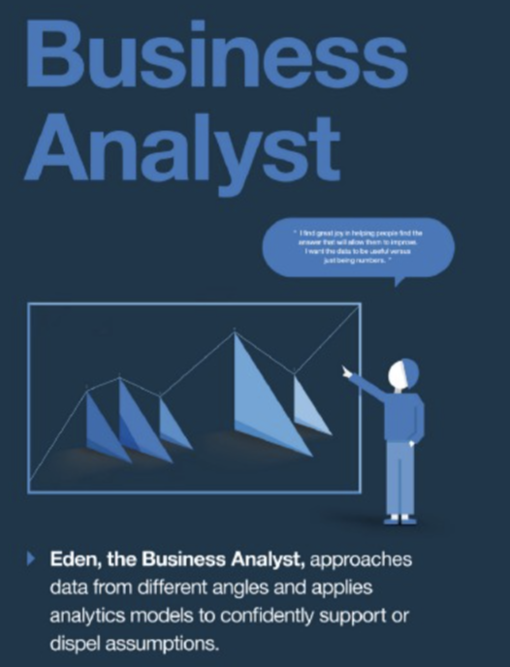
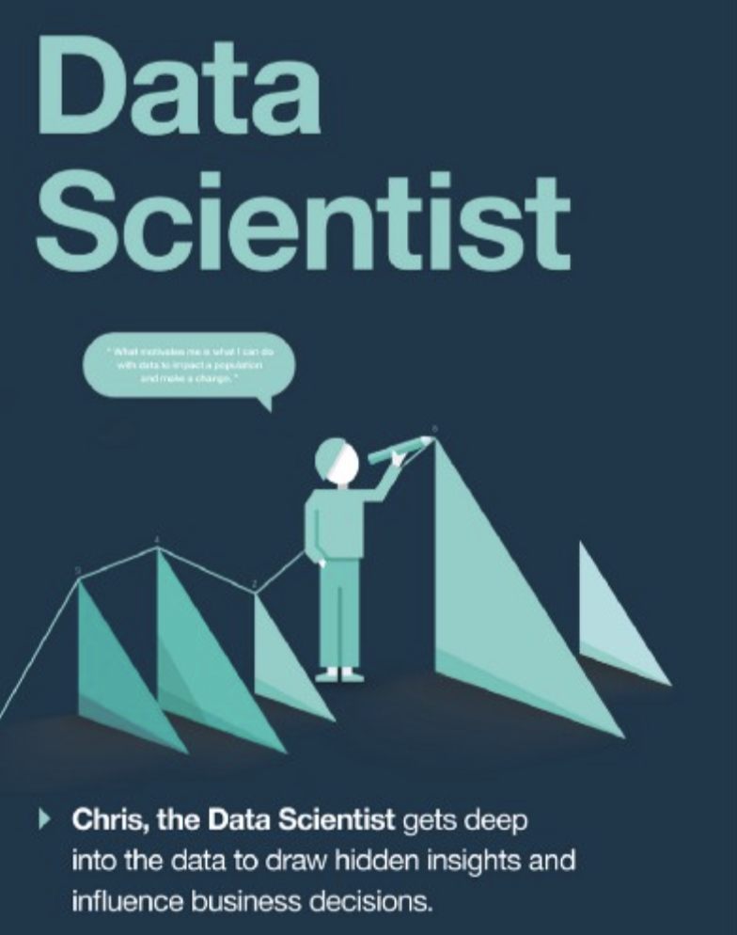
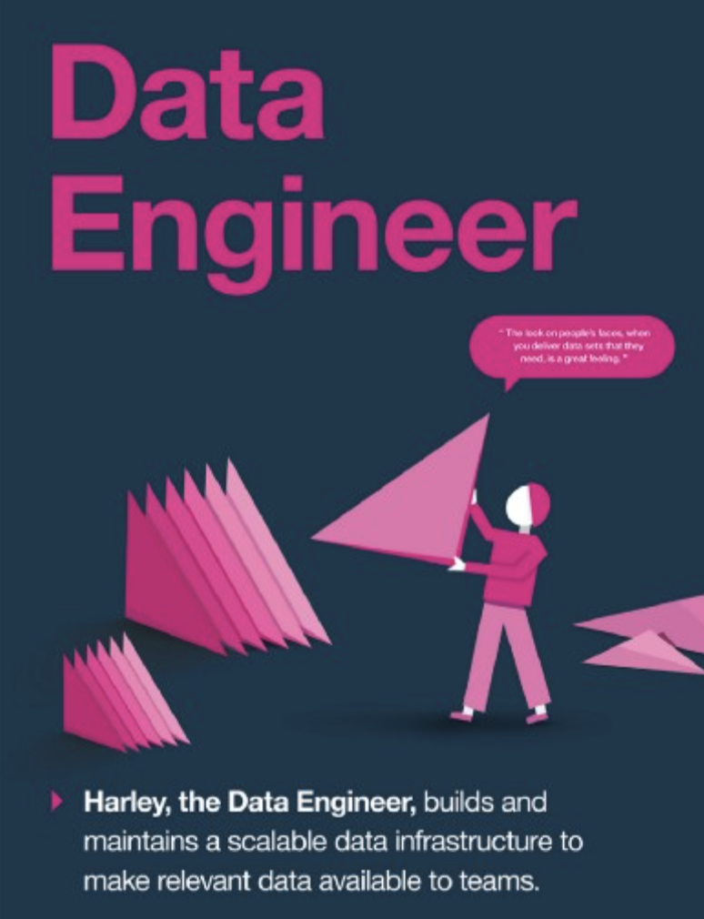

Slide 8
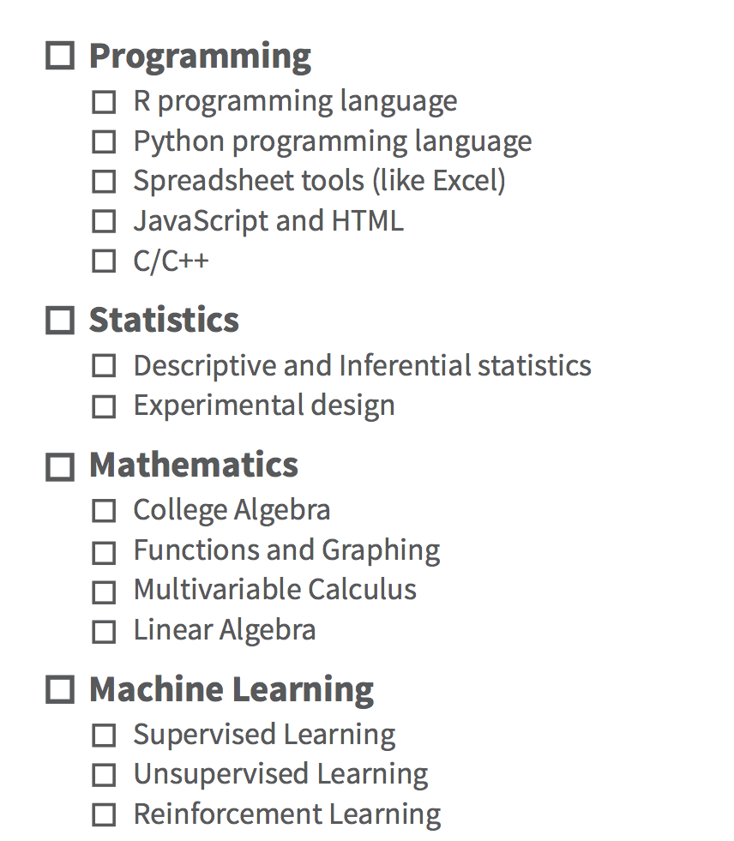
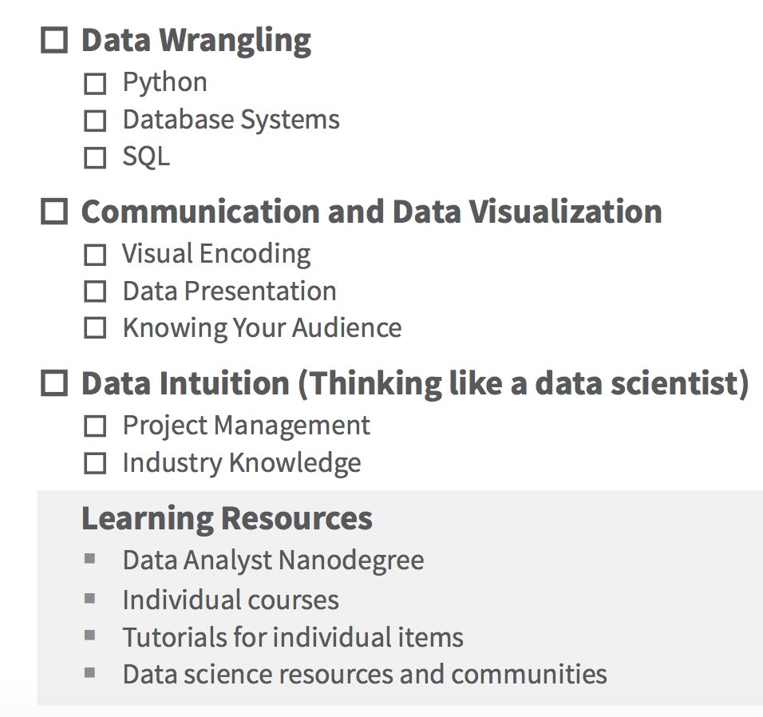
Data Scientist Basic Skill Sets

Slide 9
This course will cover
Practical Machine learning Algorithms and Techniques
Data Analysis and Visualizations with Python
Practical Machine Learning Projects

Slide 10
Data Science Tools
Python
R
Tableau
Etc.

Slide 11
Why learn Python for data analysis?
Python has gathered a lot of interest recently as a choice of language for data analysis. I had compared it against SAS & R some time back. Here are some reasons which go in favour of learning Python:
Open Source – free to install
Awesome online community
Very easy to learn
Can become a common language for data science and production of web based analytics products.
Needless to say, it still has few drawbacks too:
It is an interpreted language rather than compiled language – hence might take up more CPU time. However, given the savings in programmer time (due to ease of learning), it might still be a good choice.

Slide 12
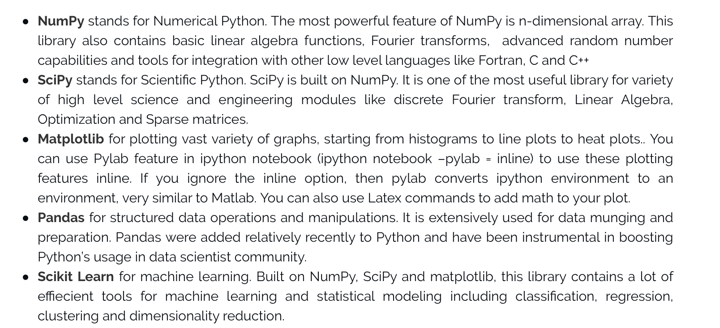
Python useful data science packages

Slide 13
Practical Data science with python

Slide 14
Install jupyter notebook for python
Open the “terminal”
sudo pip install --upgrade pip
sudo pip install jupyter

Slide 15
https://www.anaconda.com/download/#macos

Slide 16
Jupyter notebook tutorial

Slide 17
Python Pandas Package
https://pandas.pydata.org/pandas-docs/stable/10min.html

Slide 18
Statistics and Linear Algebra Review

